Slide 1
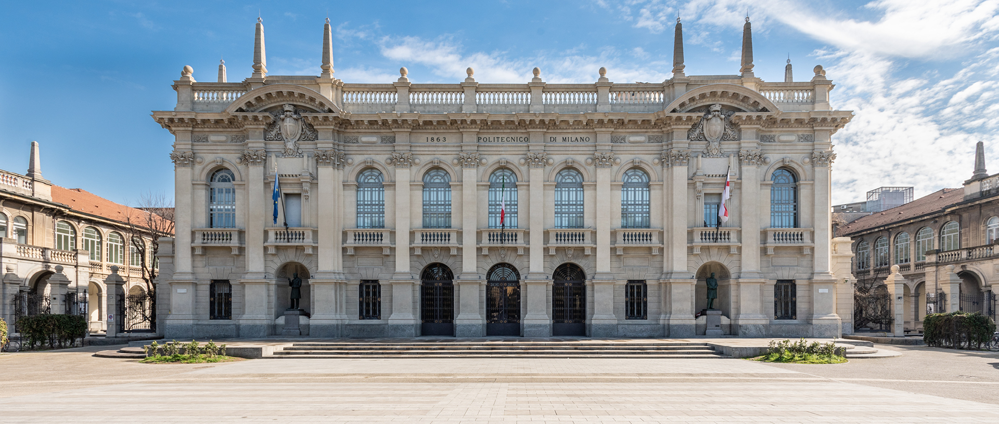

Titolo presentazione sottotitolo
COMPUTER MUSIC-LANGUAGES & SYSTEMS
FABFOUR | HOMEWORK #1
Milano, XX mese 20XX
Presented by:
Amico Stefano Antonio(10937333)
Anand Abhijeet(10859656)
Pletti Manfredi(10493741)
Portentoso Alice(10664207)
Presented to:
Prof. Fabio Antonacci
Prof. Marco Olivieri

Slide 2
ABOUT
Homework Topic : Didactic tool for learning/teaching distortion effect
Objectives :
To create a didactic tool in SuperCollider for learning and teaching the distortion effect.
The application/tool should be controllable by the user using the GUI
Developed tool : FabDist
Software used : SuperCollider IDE
Github link : https://github.com/polimi-cmls-23/group6-hw-SC-Fab_Four
Features :
Produces one or two sine waves and applies various distortion techniques to the generated sound.
GUI controls parameters such as input gain, output gain, distortion type, filter and cut-off frequency.
FabDist Teach- Explore various types of distortion along with time/frequency graphs and transfer function definition and plot.
FabDist Learn- Quiz section where user has to recognise the distortion type from time/frequency representation.

Slide 3
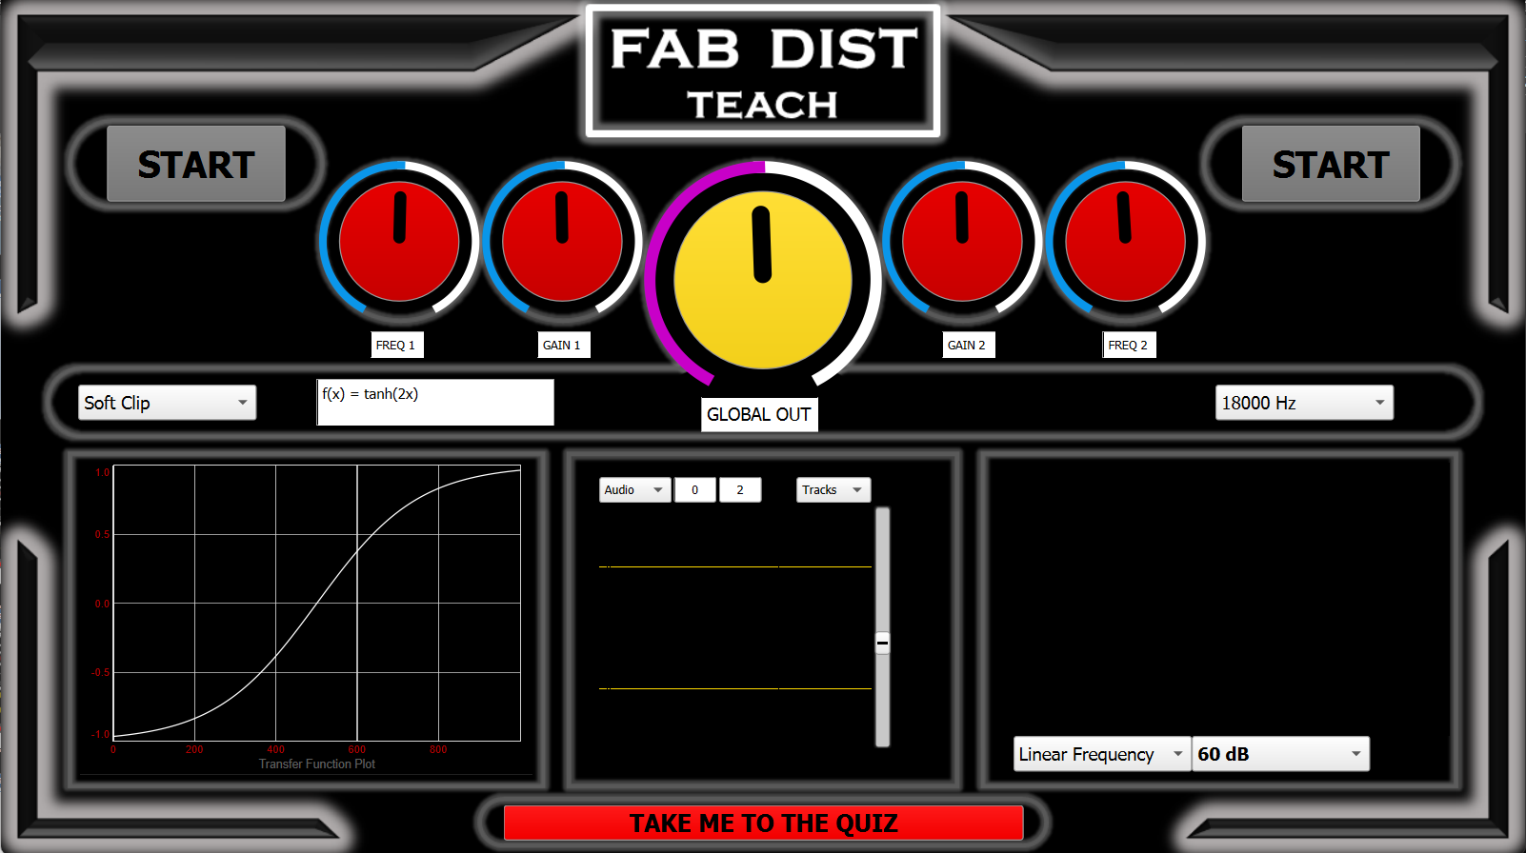
FAB DIST – TEACH SECTION

Slide 4
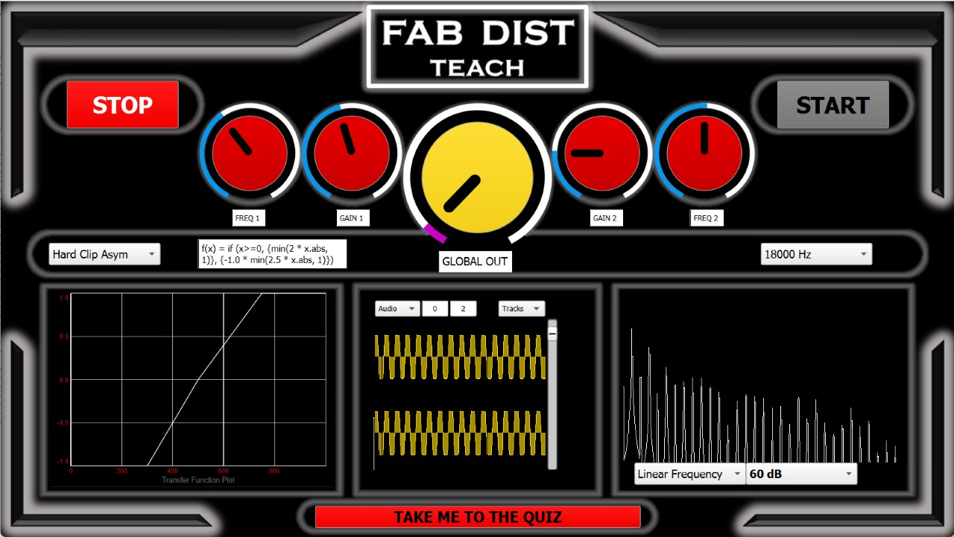
FAB DIST – TEACH SECTION

Slide 5
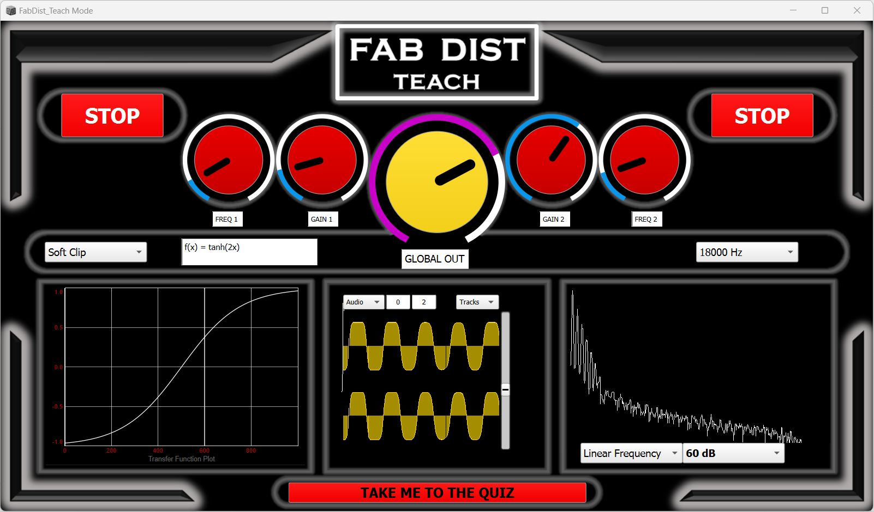
FAB DIST – TEACH SECTION

Slide 6
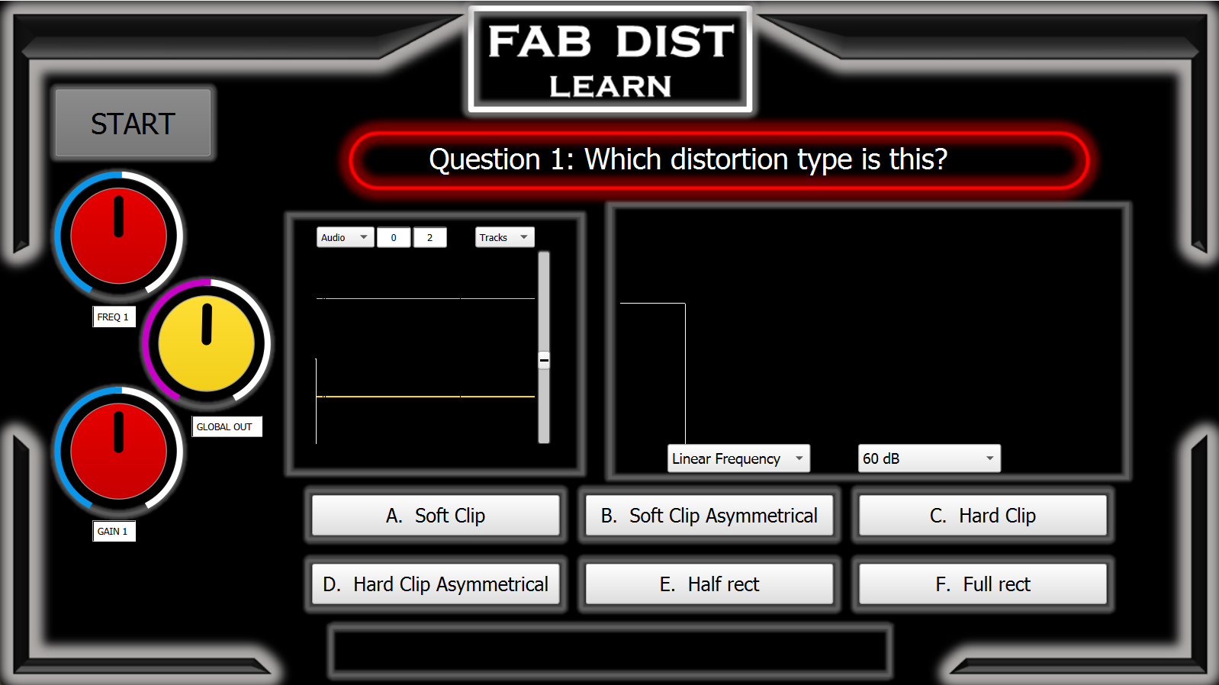
FAB DIST – LEARN SECTION

Slide 7
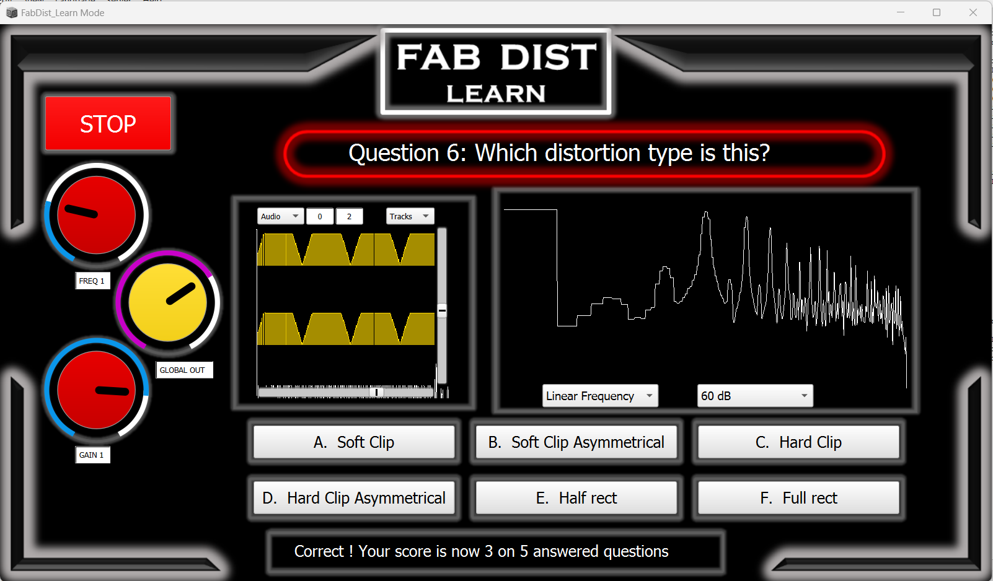
FAB DIST – LEARN SECTION

Slide 8

THANKS
FOR YOUR KIND ATTENTION !

